Slide 1
Python: Conditionals
Lesson 5

Slide 2
Review
Operators
Assignment Operators
Logical
Bitwise
Binary Numbers

Slide 3
Review Questions

Slide 4
What will be displayed by this program?
num1 = 5 num1 += 4 print(num1)
4
1
9
6
Correct answer: C. 9

Slide 5
What will be displayed by this program?
val1 = True val2 = False print(not(val1 or val2))
False

Slide 6
What will be displayed by this program?
Convert the binary number 10011 into decimal (the regular number system).
Convert the decimal number 37 into binary.
Correct answer: 19
Correct answer: 100011

Slide 7
Conditionals

Slide 8
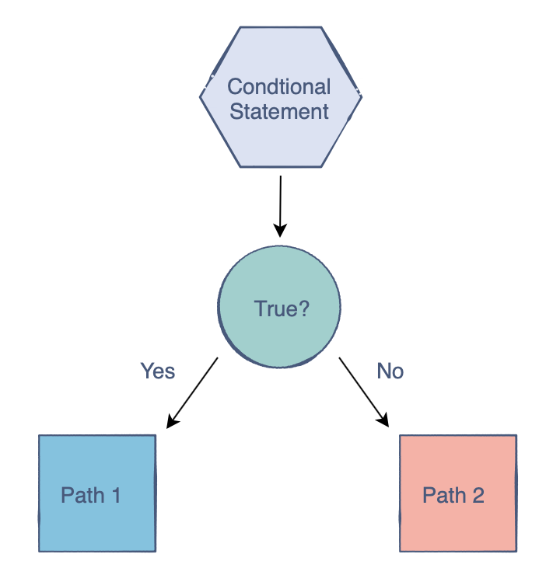
What are conditional statements?
A boolean expression that if True will execute a piece of code
Considered control structures
Integral part of Python
3 types of conditional statements

Slide 9
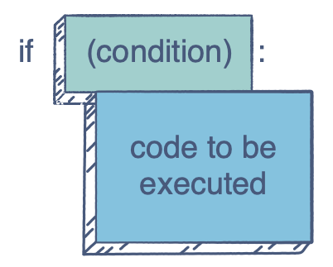
If statements
Using it with logical operators
Nested if statements
Creating and editing values
Example:
if (num = 3):
print(“Hello”)

Slide 10
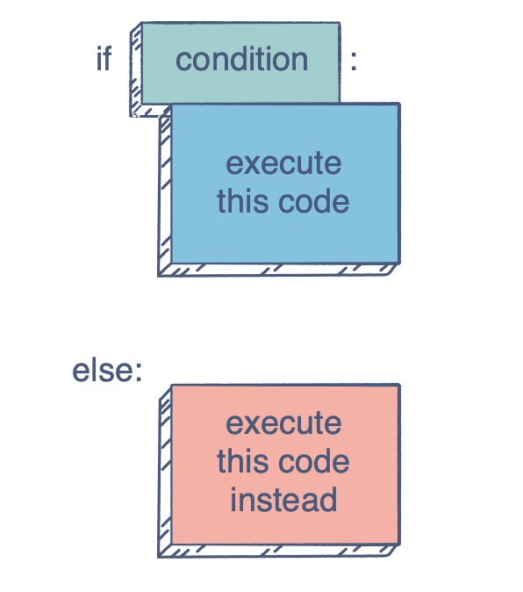
If-else statements
Example:
if (num = 3):
print(“Hello”)
else:
print(“Bye”)

Slide 11
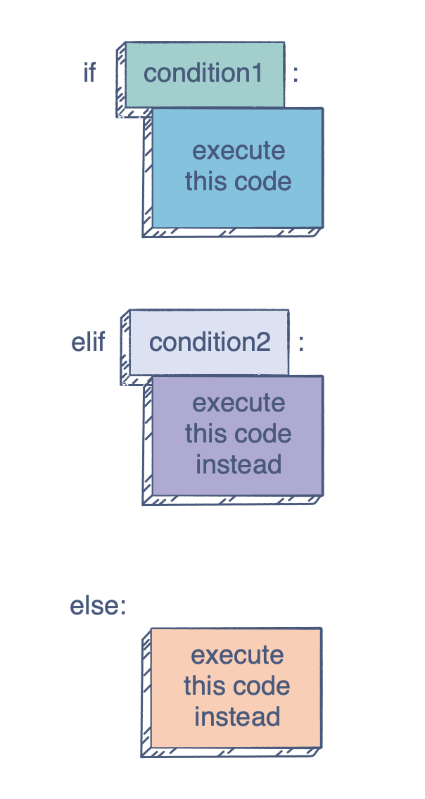
If-elif-else
Example:
if (num = 3):
print(“Hello”)
elif (num = 6):
else:
print(“Bye”)

Slide 12
Practice!
What will be displayed by this program?
num1 = 6
num2 = 9
if (num1 > num2):
print(“Greater than”)
Greater than
Nothing
Less than
None of the above
Correct answer: A. Greater than

Slide 13
Practice!
What will be displayed by this program?
num1 = 4
num2 = 8
if (num1 < num2):
num1 = num1 + 1
print(num1 + num2)
elif (num1 > num2):
num1 = num1 - 1
print(num1 + num2)
else:
print (“Equal numbers”)
Equal numbers 12
13
11
12
Correct answer: B 13

Slide 14
Let’s do some coding!
Write a program that will allow the user to input a number, and determine whether the number inputted is odd or even.
Link

